Slide 1
Are you already secure?
Prevention: Blocks threats that controls can identify
Detection: Finds yet-unknown threats that get past your preventative controls
Notes:
You have firewall and anti-virus protecting your network. Why do you need anything more?
For years, firewall and AV have been standard – recognized as essential. But you need more than preventative security… you need detective security as well.
What happens when something gets past those defenses?

Slide 2
Today in security, we have an over-reliance on prevention!
Notes:
We’re going to talk about handling objections related to prevention:
“I don’t need this because I have Firewall and AV”
“Is Perch blocking anything?”

Slide 3
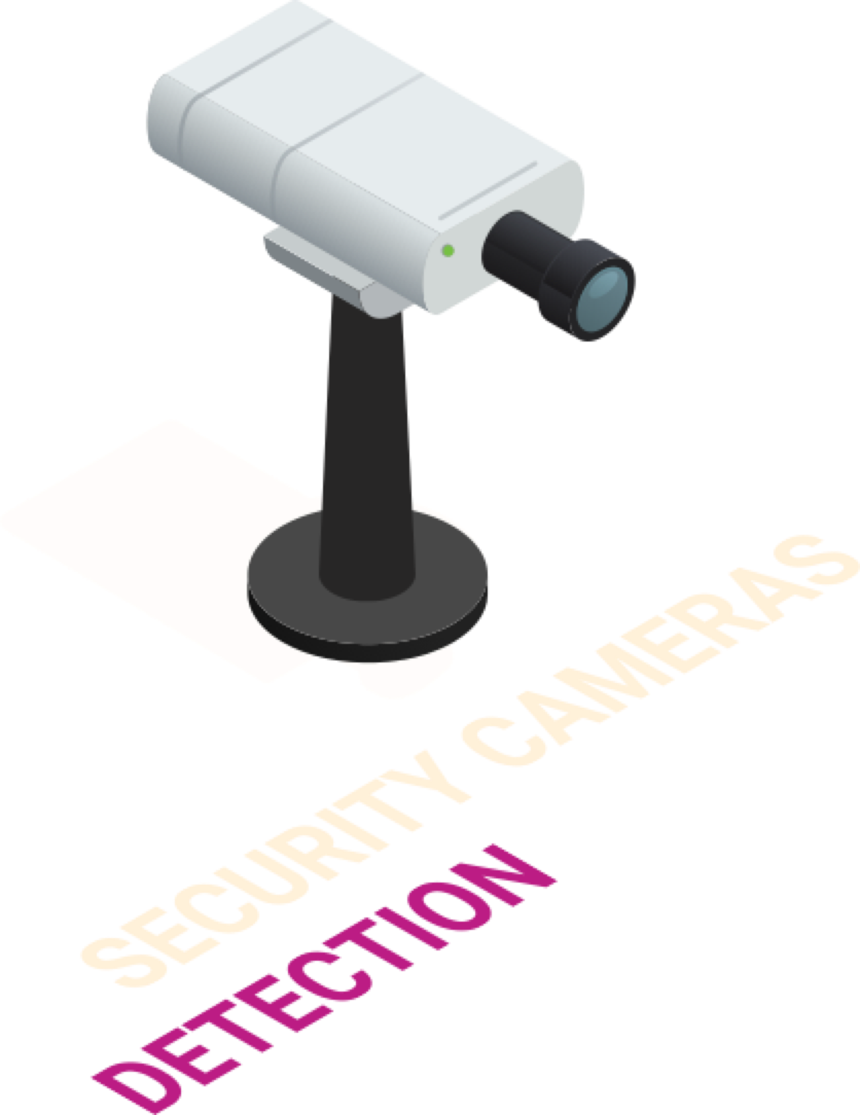
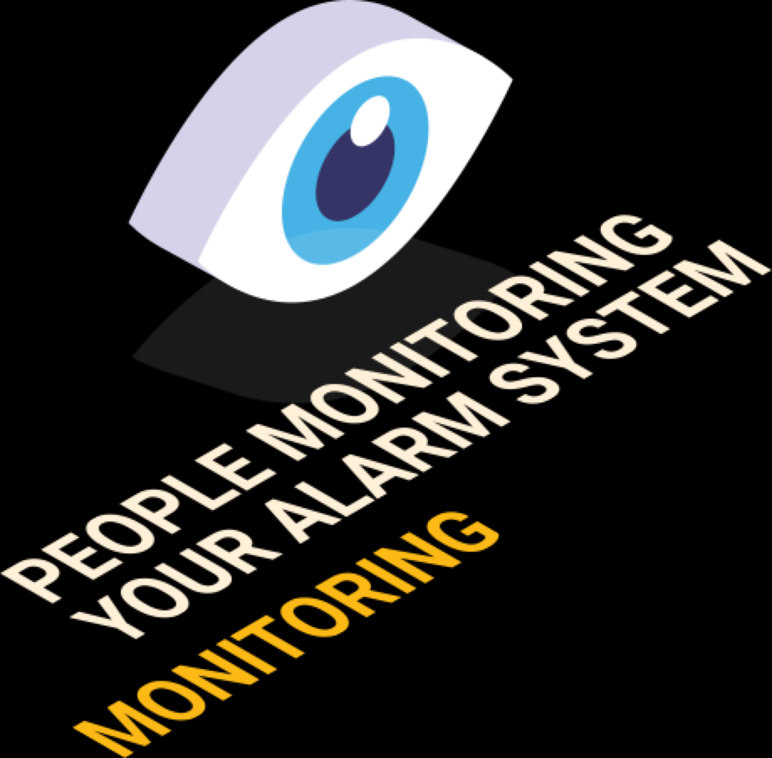
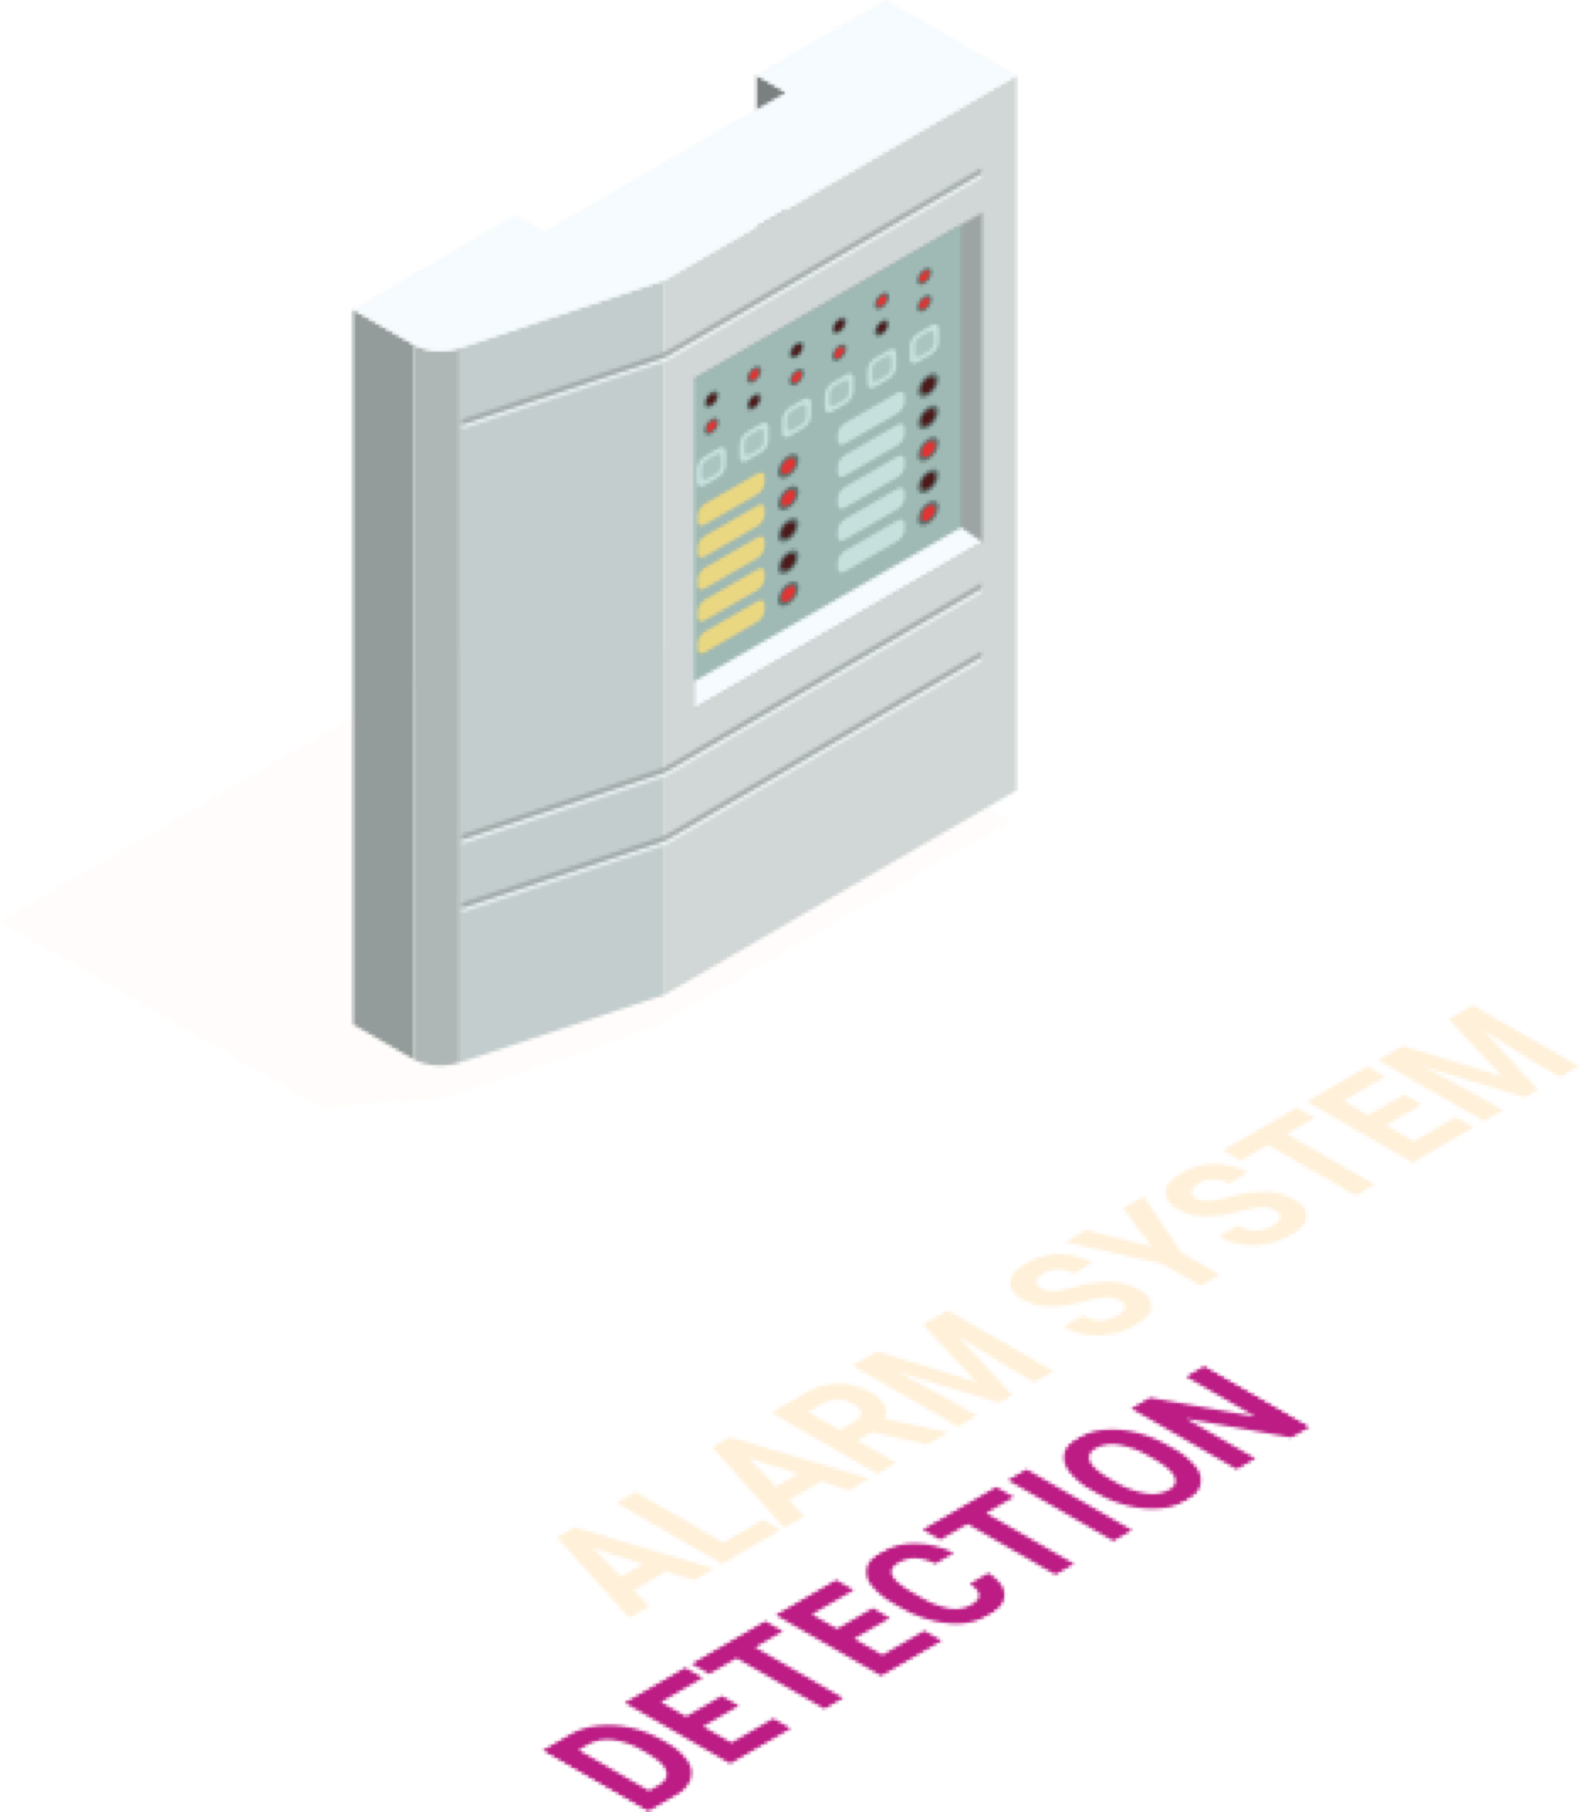
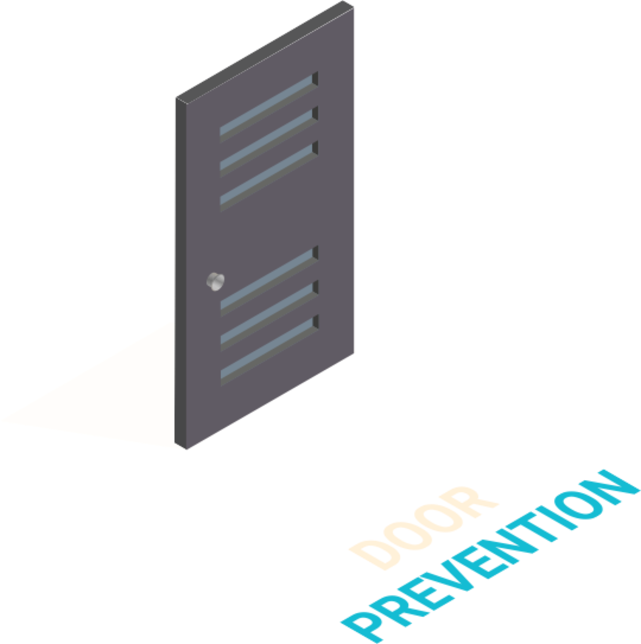
Home Security
PREVENT | Front Door
 | Lock
DETECT | Glass Break Sensors
 | CCTV Cameras
 | Alarm System
MONITOR | Humans keeping watch
Notes:
Think about the physical security system you have at your office:
You prevent unauthorized entry with doors and locks.
You detect what gets past those measures with things like glass break sensors, cameras, and and a connected alarm system.
You have people monitoring what the detective tools catch, to alert you and contact authorities.
If you compare that to what’s happening right now with cyber security…

Slide 4
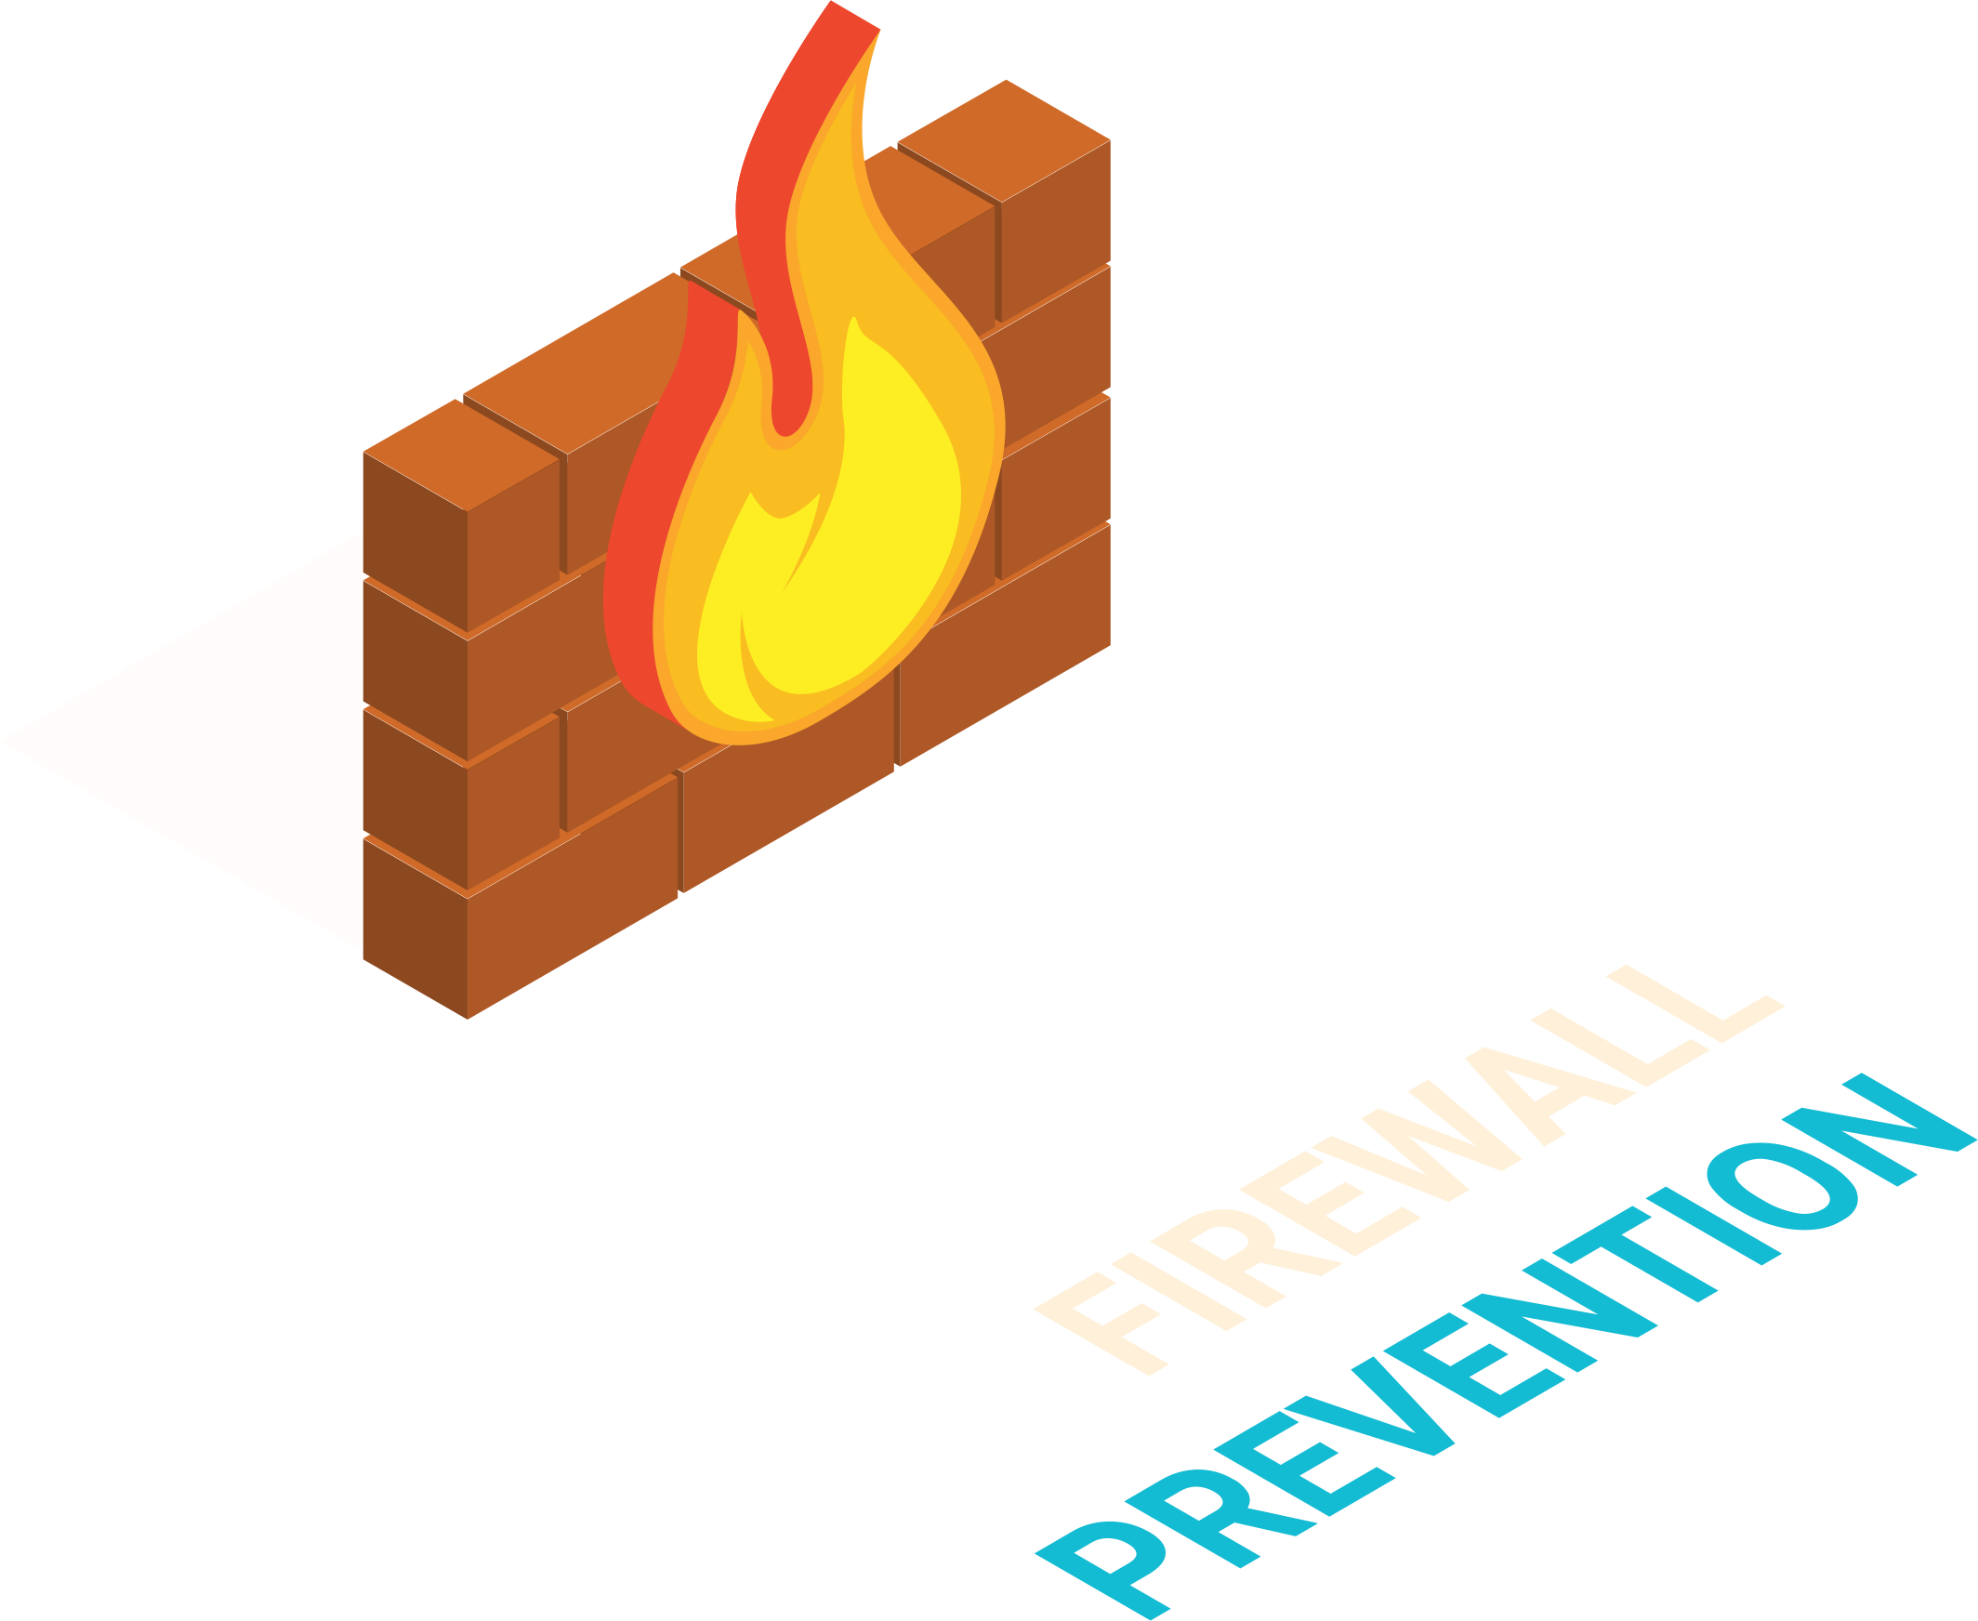
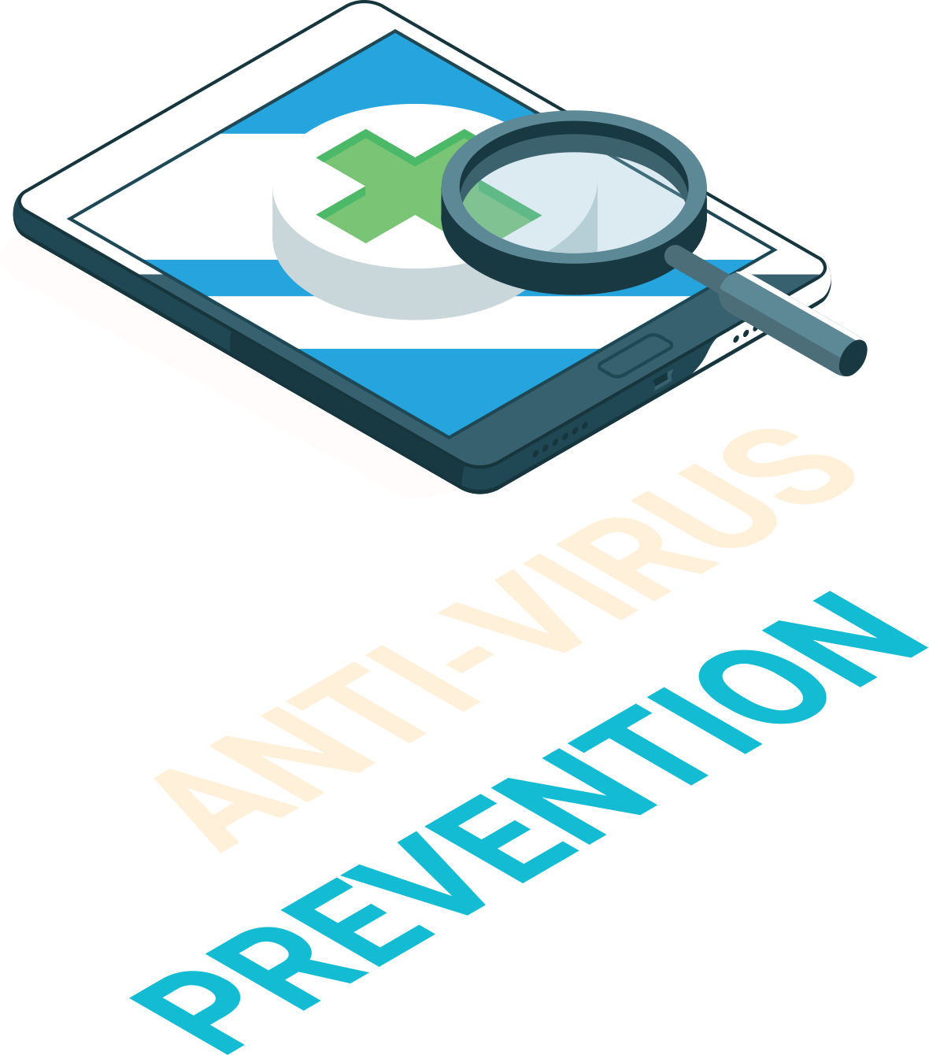
Current Cyber Security
PREVENT | Firewall
 | Anti-virus
DETECT | Glass Break Sensors
 | CCTV Cameras
 | Alarm System
MONITOR | Humans keeping watch
Notes:
you’re left with only the preventative measures if all you’re using is anti-virus and firewall.

Slide 5
Prevention alone can’t stop all threats.
When tools encounter an unknown threat (they were not designed to stop), they simply don’t work. …and it’s difficult to identify and protect every entry point.
Notes:
[read]
We may not take measures to protect from an alien invasion, because that would be unlikely… and costly.
This does make me wonder how one would protect cows from this situation.

Slide 6
Prevention alone can’t stop all threats.
They have to let the right things through to reduce daily business disruption… which makes it impossible to keep all the threats out. And preventive tools generally only know what the intruder says it is.
Notes:
Preventative measures generally only know what the intrusion says it is.

Slide 7
Prevention alone can’t stop all threats
With prevention only… how would you be alerted to a threat?
With prevention only… how would you identify and respond to a threat?
Notes:
You can’t monitor when you don’t have detective tools in place

Slide 8
The reality: prevention only stops a slice of the threat pie.

Slide 9
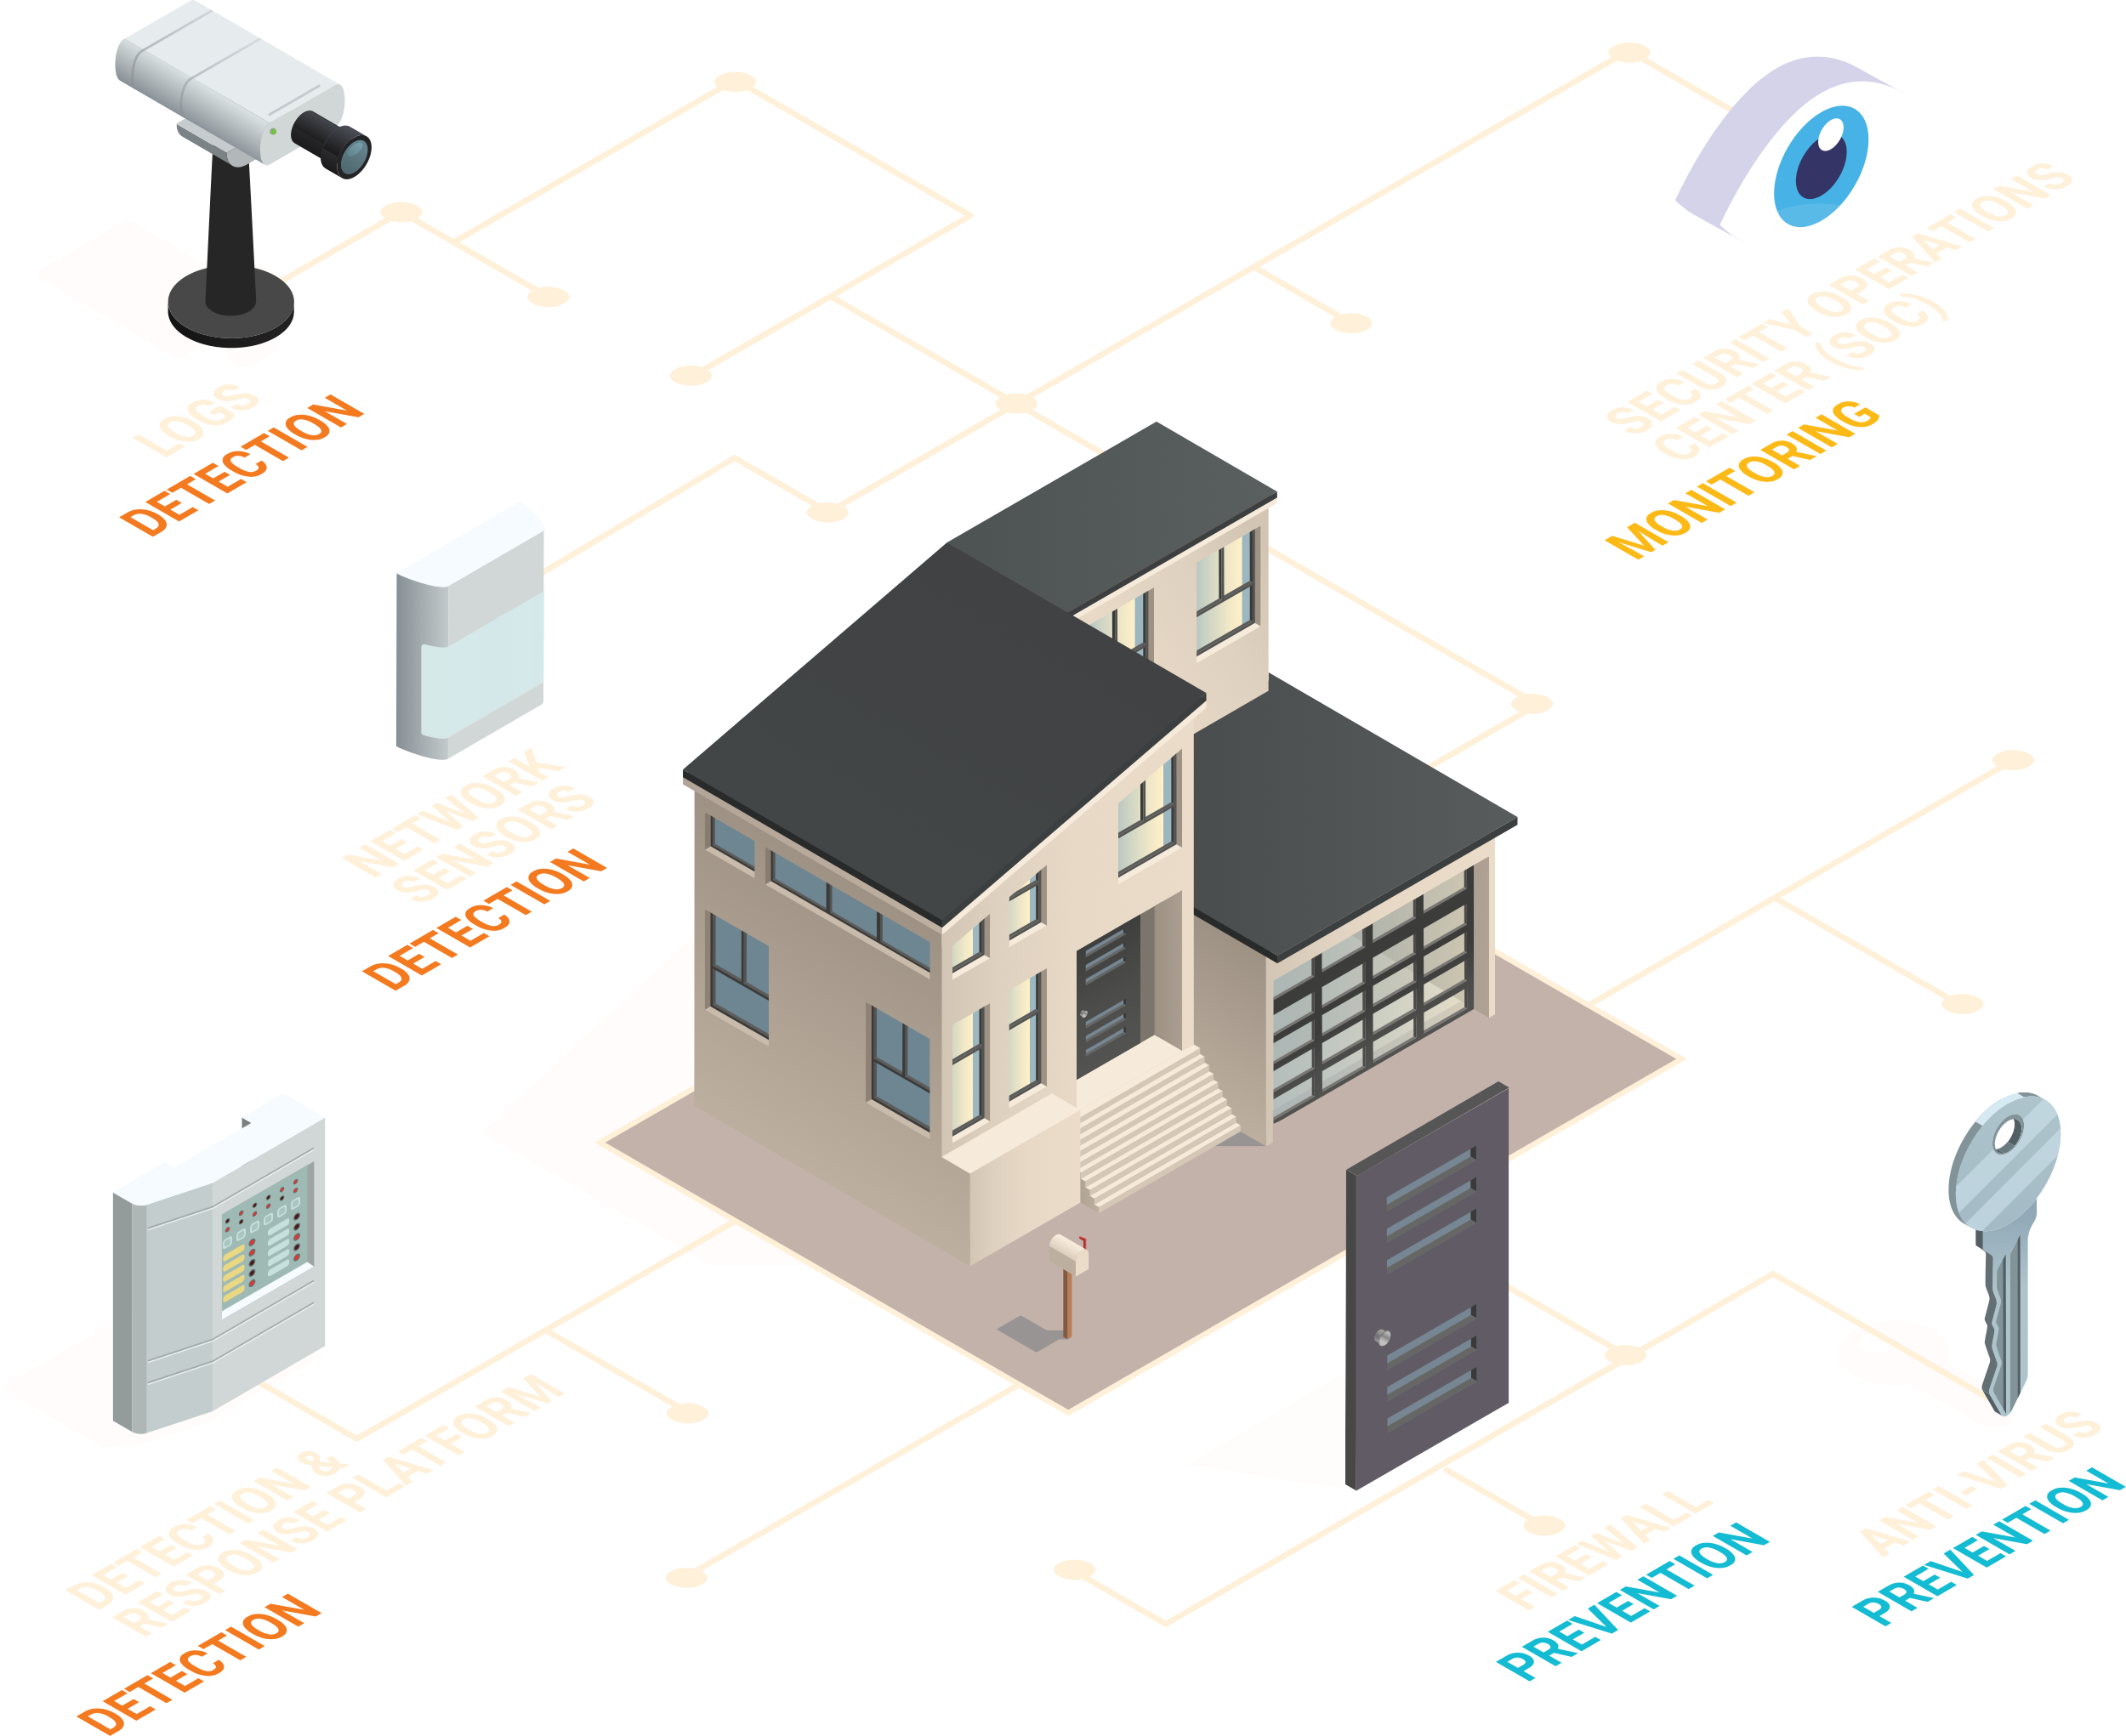
Future Cyber Security
PREVENT | Firewall
 | Anti-virus
DETECT | Detection & Response Platform
 | Network Sensors
 | Log aggregation
MONITOR | Security Operations Center
Notes:
With ALL the pieces in place, this is what your cyber security looks like.

